Slide 1

Table of Contents
Introduction .................................................................................................................................................. 2
Getting Started: Helpful Information Links ................................................................................................... 2
Submit Application in Momentum ................................................................................................................ 3
Application Information .................................................................................................................... 3
Complete Application Fields ............................................................................................................. 6
Review Application............................................................................................................................ 8
Upload Application Document(s) ...................................................................................................... 9
Application Review and Approval ................................................................................................... 12
Upload Drawings in ePlan ........................................................................................................................... 13
Plan Screening............................................................................................................................................. 16
Applicant Fee Payment ............................................................................................................................... 16
Approved Plans and Permit ........................................................................................................................ 18

Slide 2
Introduction
Welcome to Prince George’s County’s Momentum, a new online system that allows customers to submit applications, upload documentation, and make payments online. When the applications have been reviewed and approved, customers can print their licenses/permits at work or home.
This user guide provides the basic steps involved in utilizing the system. It has been prepared as a general reference guide and is not intended to present every detail or situation of the process.
Getting Started: Helpful Information Links
You will use the ePlan system in conjunction with Momentum to upload your plans. The following links provide helpful information guides and a "How to" video on ePlan.
ePlan Applicant Quick Start Guide ePlan Applicant User Guide 2.0
ePlan System Applicant Training Video Momentum FAQ

Slide 3
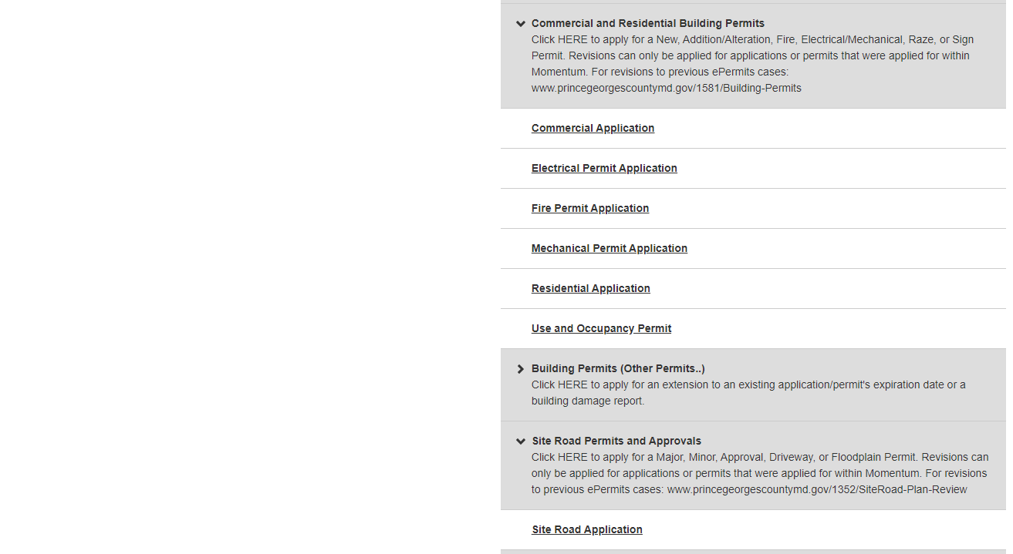
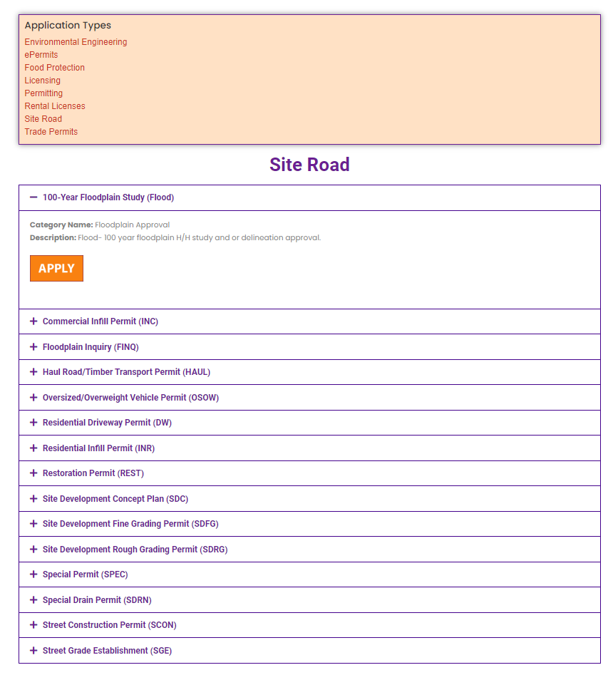
Submit Application in Momentum
A. Application Information
Step 1: Visit the website https://momentumhome.princegeorgescountymd.gov/
Step 2: Click on the login button
Step 3: Log in with your Username and Password. Refer to the Profile User Manual on how to create an account if you don’t have a login.
Choose the “I want to” option from the top menu if you do not know what permit type is needed for your project and the system will guide you up to step 6. Go to the next step if you know what permit is needed for your project.
Step 4: From the Momentum Dashboard, select “Apply Here”
Step 5: Click on Site Road Permits to select the applicable Site Road application

Slide 4
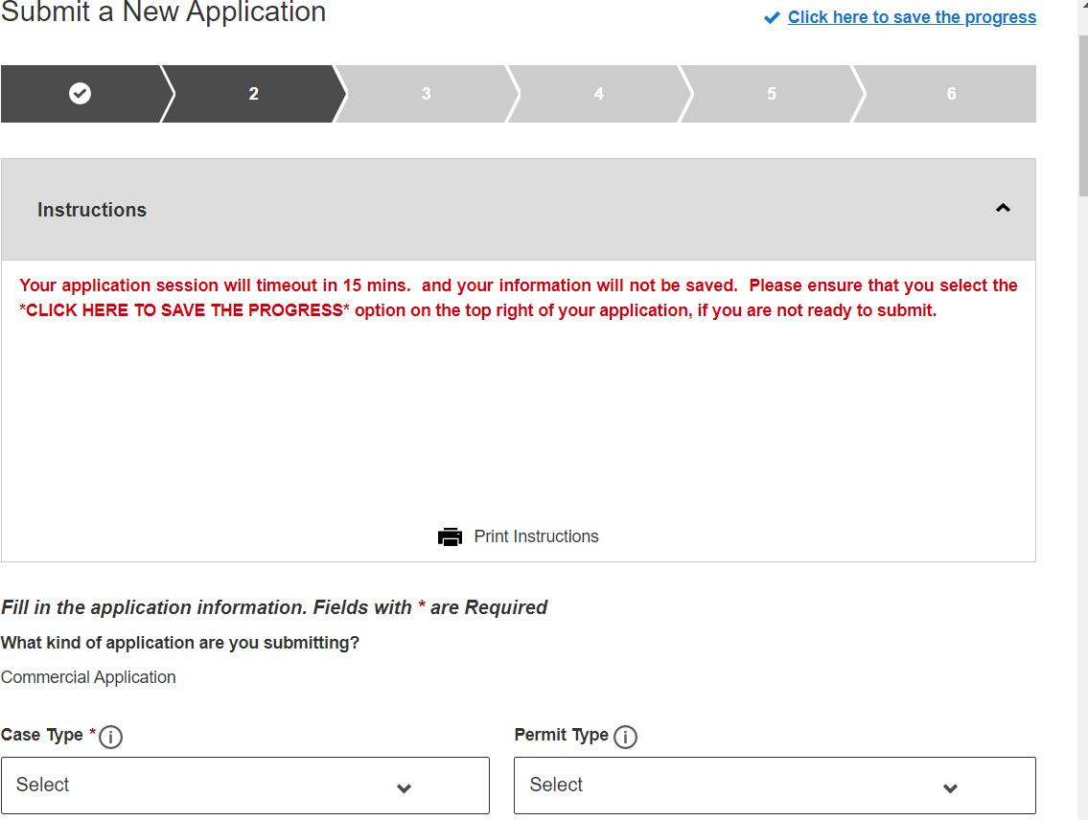
Step 6: Use the drop-down menu to select a case type and permit type

Slide 5
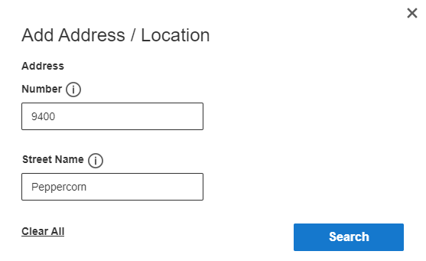
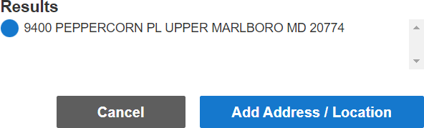

Step 7: Add a primary site address in the Application Address / Location Section
Click on the Add Address / Location button
Enter a Tax Account # or address (whichever is specified in the application)
click search (If a match is found, the system will display the tax account # or address in the results section)
Select your Tax Account # or address in the results section and click on the Add Address / Location button to associate the tax account # or address to your application
Note: To ensure that the system can locate the address please only enter the Street # and Street Name in the search. Do not include any street suffix (e.g., RD, ST, CT, etc.) in the search
Step 8: Click Save and Continue

Slide 6
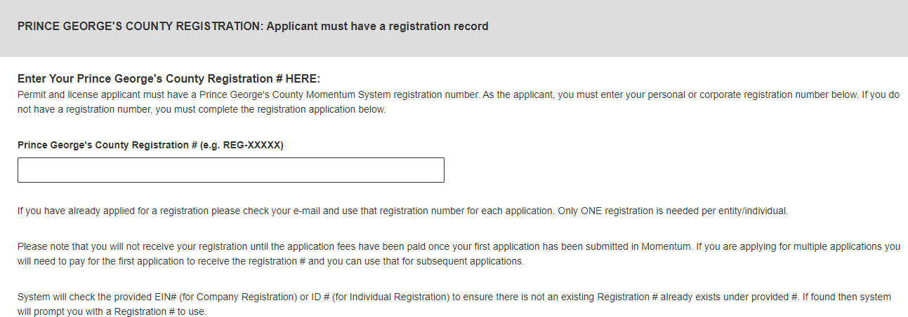
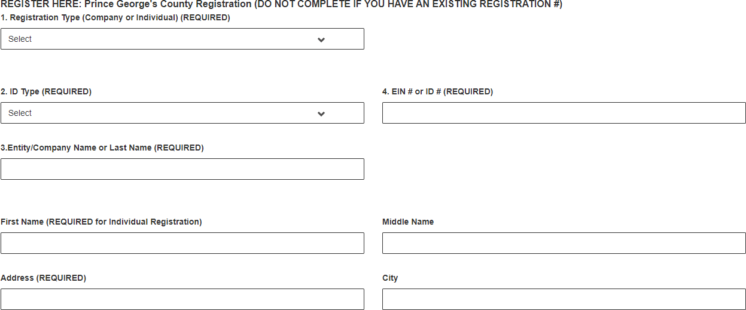
B. Complete Application Fields
Step 9: Complete all required fields as listed on the application.
Step 10: Enter your Prince George’s County Registration number in the registration number field If you already have an existing registration # (Starts with REG-). Otherwise, leave this field blank and you will be able to apply for registration in the next section of the application
Step 12: If you do not have a registration # (REG-XXXXX), please proceed to the REGISTER HERE section for either an individual or a company registration.

Slide 7
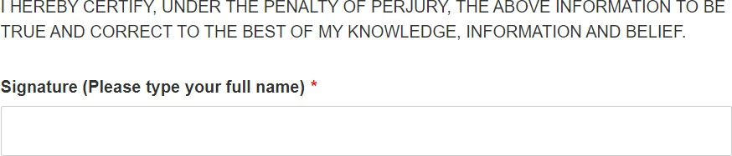



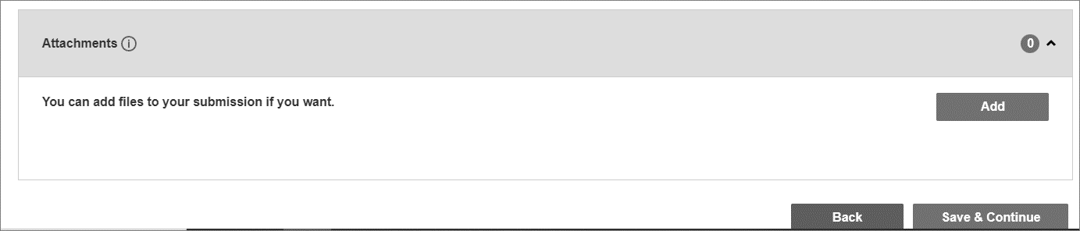
NOTE: At the end of the application, carefully review the acknowledgment section for required fees, documents, and important information.
Step 11: Type the Name of the person who completed the application
Step 13: Click Save and Continue.
Step 14: Add any attachments in this section. click save and continue.
NOTE: Application specific documents will be required to be uploaded later in the process.

Slide 8
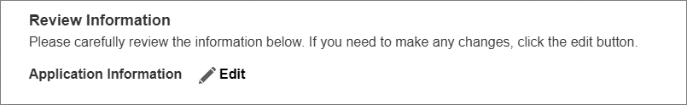


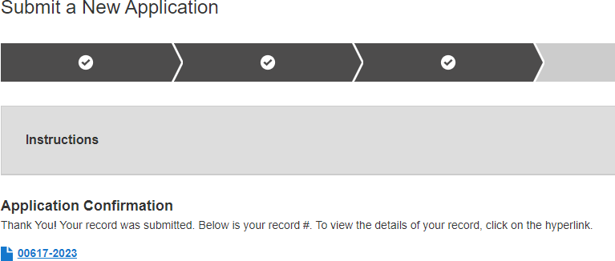
C. Review Application
Step 15: Review the application and, if needed, click on the edit icon to make changes.
After reviewing the application, scroll down and click Submit.
Once the application is submitted a Momentum application # will be generated.
PLEASE NOTE: YOUR APPLICATION IS NOT YET COMPLETE. YOU MAY NEED TO UPLOAD THE REQUIRED DOCUMENTS TO COMPLETE YOUR APPLICATION SUBMITTAL.
Step 16: Click on the application # link to view outstanding tasks.

Slide 9
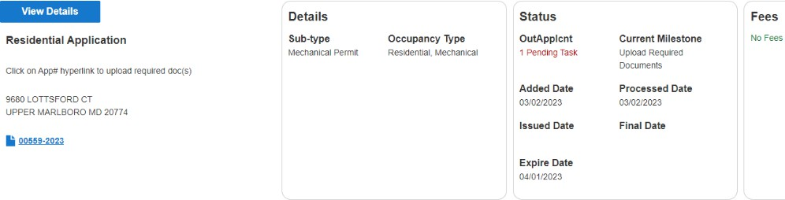
D. Upload Application Document(s)
Step 17: From your dashboard, locate your application and click on the view details button.
You will be tasked to upload the required documents.
Note: The status shows what task needs to be completed for the application to move forward in the process. The current milestone shows where an application is in the process.

Slide 10
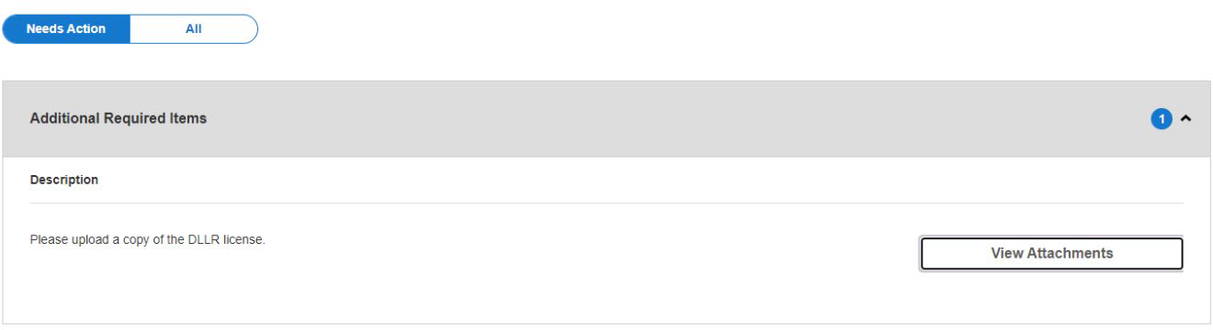
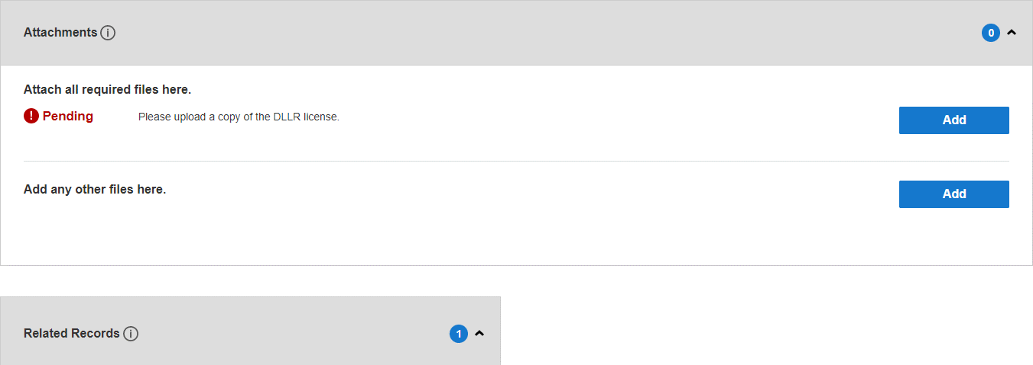
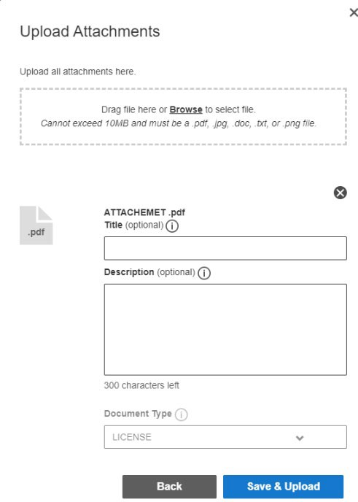
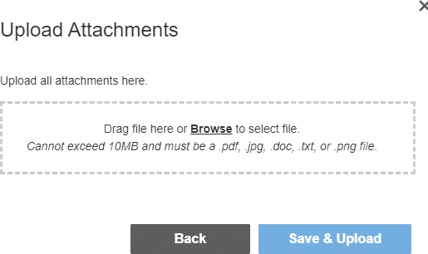
Step 17: To attach the required documents, click on the view attachments button, then the add button for each document to be uploaded. Follow the screens to browse for the file and then click Save & Upload
Note: There is a short time lag for each attachment to upload into the system.

Slide 11
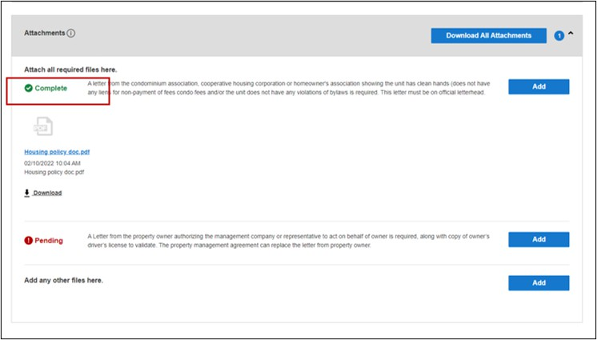
Step 18: Each successfully uploaded attachment will come back as complete. Once all documents have been uploaded, you can return to my dashboard to confirm the status.
The current milestone will change from upload required documents to application pre-screening when this task is completed.

Slide 12
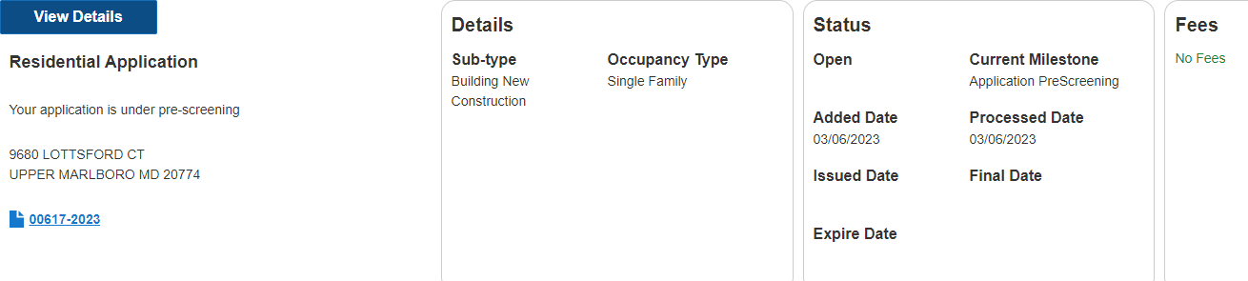
E. Application Review and Approval
If your application status says open and the current milestone says application under review, then your application has been successfully submitted for review. You will be notified via email and text if any additional information is needed.

Slide 13
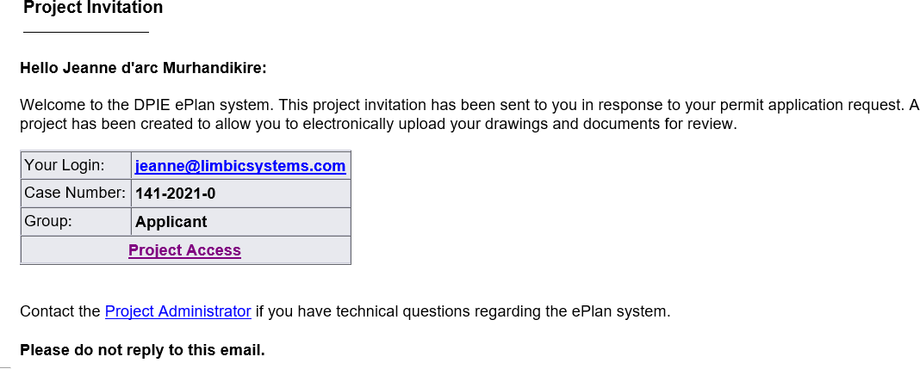
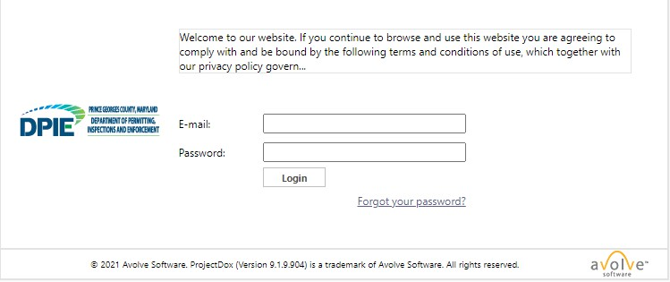
Upload Drawings in ePlan
After your application is processed, an ePlan invitation will be sent to your email address. The email will contain your login information, case number, and project access link. Click on the “Project Access” link to enter the ePlan login screen. A sample invitation is shown below:
Test
test@email.com
1. Click the “Project Access” link in your email to access the ePlan site and log in.
DO NOT use “forgot your password” on your first log in. Instead, enter your email address and the temporary password that was provided in the invitation email.

Slide 14
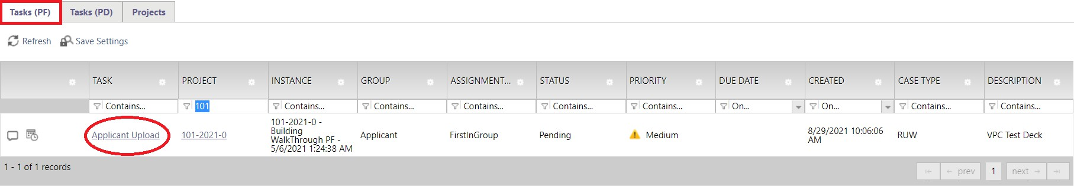
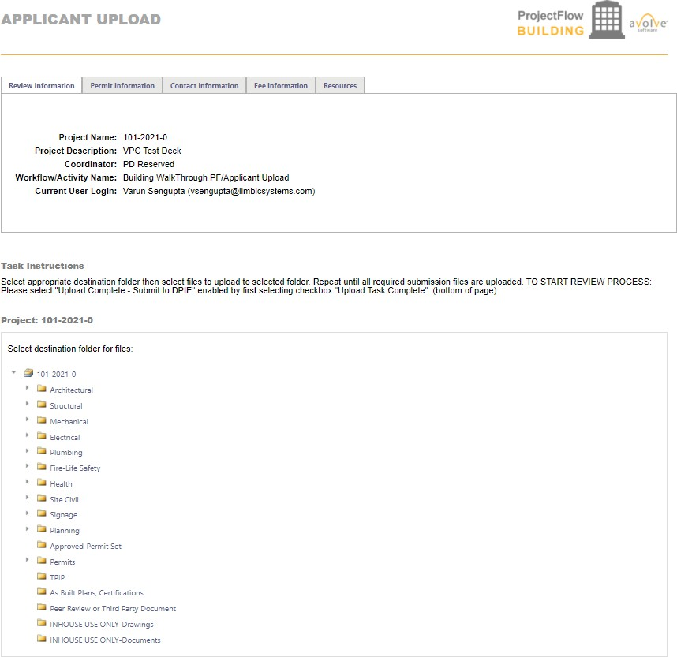
2. The task will appear on the Home screen’s Task (PF) tab. Accept the “Applicant Upload” task by clicking the applicant upload hyperlink.
The “Applicant Upload” task will open in a new window.
Upload all documents for your application under the correct folders.

Slide 15
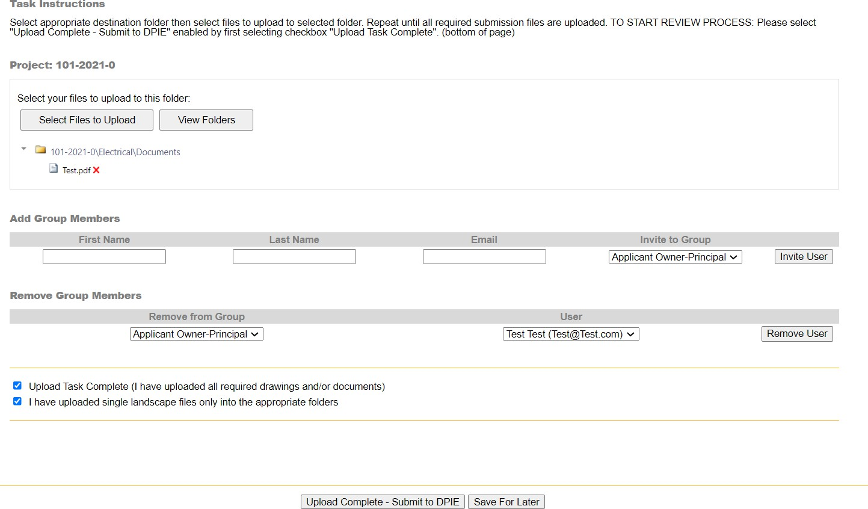
5. Confirm the checkboxes and click the upload complete-submit to DPIE button to complete the task.

Slide 16
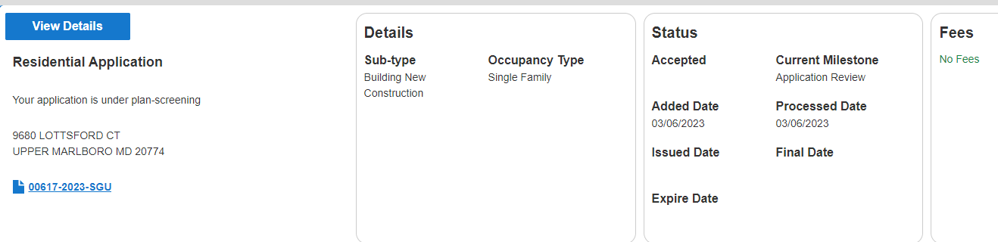
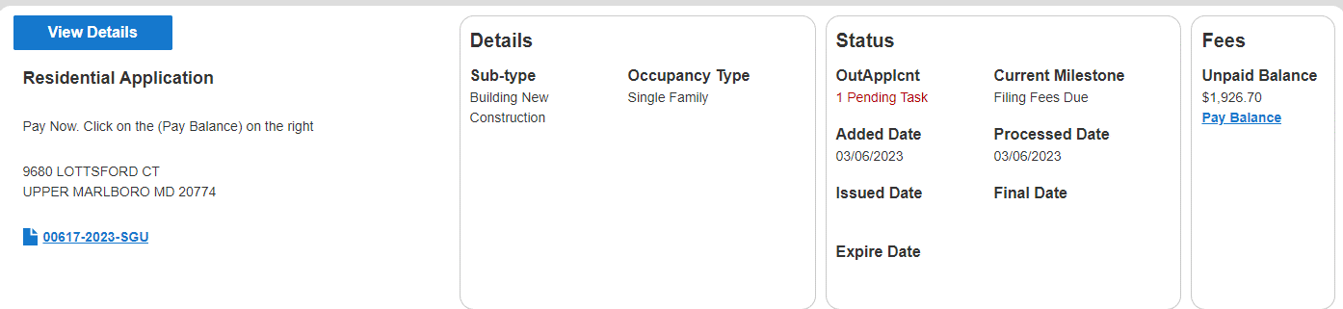
Plan Screening
Plan screening is a preliminary review of your uploaded documents in preparation for the formal review.
Your ePlan will move to the formal review stage if your submission has met all requirements.
On the other hand, if there are missing items or questions about your submittal, you will receive an email and text notification for the “Applicant Re-Upload Task”. After receiving the email, accept the task as previously instructed.
Applicant Fee Payment
You will be tasked to pay fees online (Credit Card or Check) per the Application requirements.
Click on the View Details button or Pay Balance link on the dashboard.
Review the fee balance and follow the instructions.

Slide 17
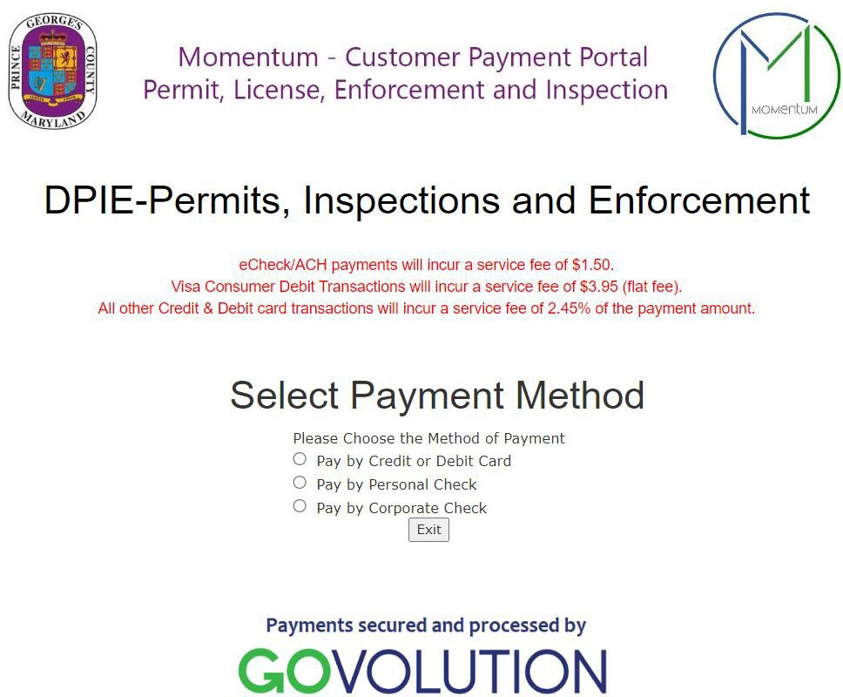
3. You will be directed to the Govolution site to process the application fees.
NOTE: Make sure you include your email address to receive your receipt.

Slide 18
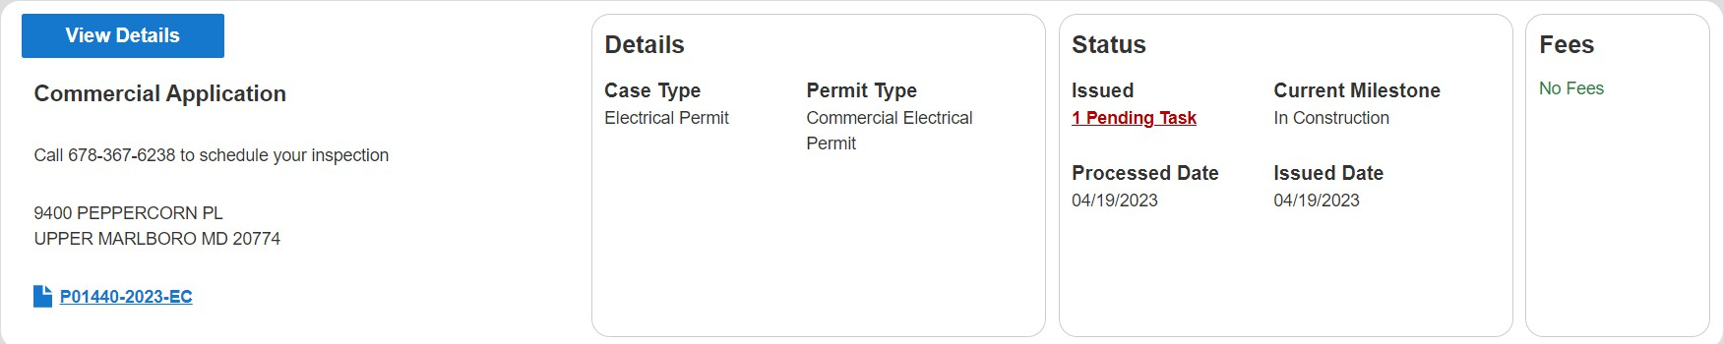
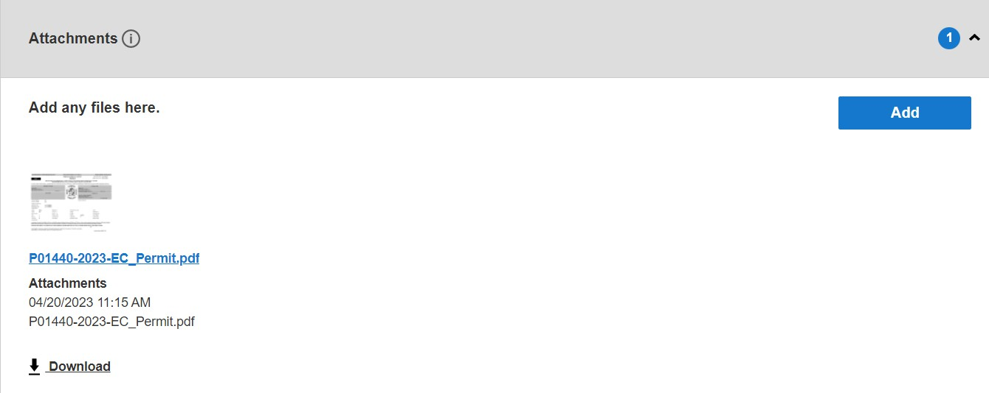
Approved Plans and Permit
Once your plans have been electronically stamped by the County and any applicable fees have been paid, the ePlan process will conclude. You will then receive an email and text notification with instructions for downloading your approved plans and permit. The email notification will direct you to the folder that contains your stamped plans.
Schedule an Inspection
A permit record will be added to your dashboard. Your permit number will begin with a P.
1. From your dashboard, locate your permit and click on the view details button.
2. Click on download in the attachments section to download the permit.

